Slide 1

Comparing Crime Rates, Population & Hotel Ratings
Project Won
Kirby Miller
Alicia Perez
Meghan Luoma
Kerry Wehner
Sara Riggs

Slide 2
Motivation
The purpose of this project is to determine if there is a correlation between crime, population and hotel ratings in select cities across the U.S. that had both similar and dissimilar populations.
Inspiration for this project was future travel plans to one of these cities.
Hypothesis: Cities with greater populations will have higher crime rates than cities with smaller populations, and cities with higher crime rates will have lower average hotel ratings.

Slide 3


Select Cities
Kansas City, MO
New Orleans, LA
Dallas, TX
Portland, OR
Charlottesville, VA
Chicago, IL
Denver, CO
Sioux Falls, SD
Las Vegas, NV
San Francisco, CA
Chattanooga, TN
Boston, MA

Slide 4
Questions
Is there any correlation between average hotel ratings and crime rate?
Is there any correlation between a city’s population and crime rate?
Is there any correlation between a city’s population and average hotel rating?

Slide 5
Brief Summary of Findings
Is there any correlation between average hotel ratings and crime rate?
There is a weak correlation.
Is there any correlation between a city’s population and crime rate?
There was very little to no correlation.
Is there any correlation between a city’s population and average hotel rating?
There is no correlation.

Slide 6
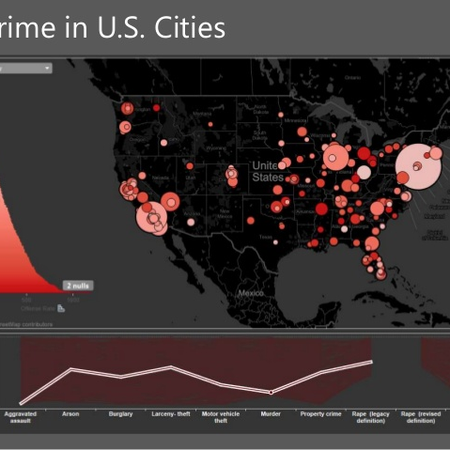
Data
City Coordinates
https://latitudelongitude.org/us/ Charlottesville, VA Coordinates
https://www.lat-long.com/Latitude-Longitude-1498463-Virginia-Charlottesville.html FBI Crime Data Explorer API
https://crime-data-explorer.fr.cloud.gov/api ORI Lookup Table (provided by: ICPSR)’
https://www.icpsr.umich.edu/files/NACJD/ORIs/STATESoris.html Crime Rate Calculation https://oag.ca.gov/sites/all/files/agweb/pdfs/cjsc/prof10/formulas.pdf Population Data
https://github.com/CommerceDataService/census-wrapper Population Labels
https://gist.github.com/afhaque/60558290d6efd892351c4b64e5c01e9b
Hotel Reviews Using Google Places Library
https://developers.google.com/maps/documentation/javascript/places

Slide 7
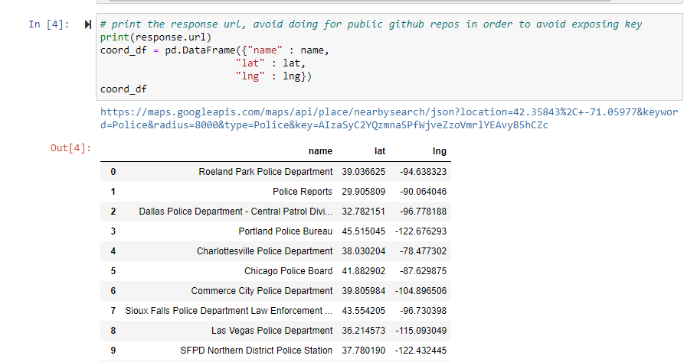
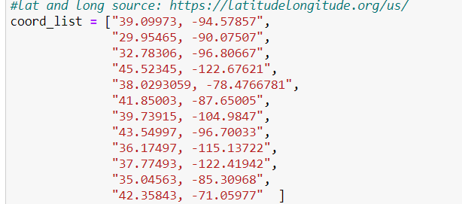
Data - Latitude and Longitude
Notes:
To get city data like police department location and hotel ratings in those cities, we needed to get Latititude and Longitude for our subsequent searches.
We used the websites (https://latitudelongitude.org/us, lat-long.com for Charlottesville) to compile a list of coordinates.
Then we pulled a list of Police stations using Google Places API. within 8000 meters of the website's city lat-long coordinates.
Then put the police station lat-long into a csv for use later.
We had to use multiple websites for the list of lat and longs as the first wasn't complete and didn't include Charlottesville.
Interestingly our Kansas CIty lat and long pulled a Roeland Park Police Station, so we adjusted that lat and long in our later searches.

Slide 8
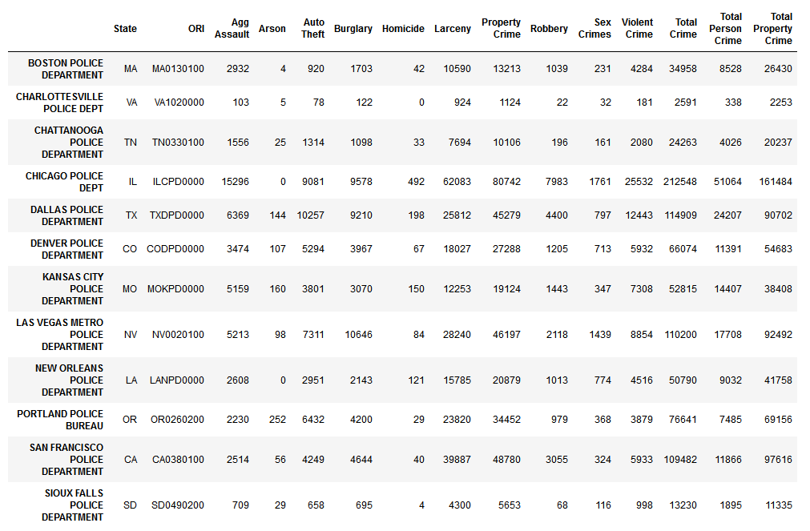
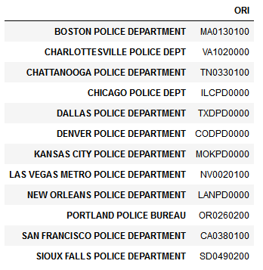
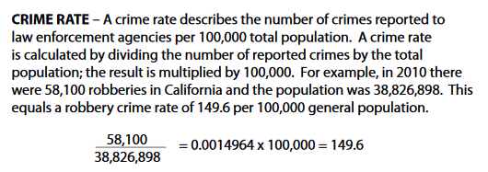
Data - Crime Data Explorer
ORI = Originating Agency Identifier
Notes:
The crime categories pulled form the FBI were: aggravated assault, arson, auto theft, burglary, homicide, larceny, property crime, robbery, sex crimes, and violent crime.
We did three totals for crimes and rates. The three categories are total crime, total person crime, and total property crime. Total crime includes all categories. Total person crime includes aggravated assault, homicide, robbery, sex crimes, and violent crime. Total property crime includes arson, auto theft, burglary, larceny, and property crime. The crime rate was calculated by taking the crime total divided by the population and multiplying by 100,000.We chose select cities across the U.S. that had both similar and dissimilar populations.

Slide 9
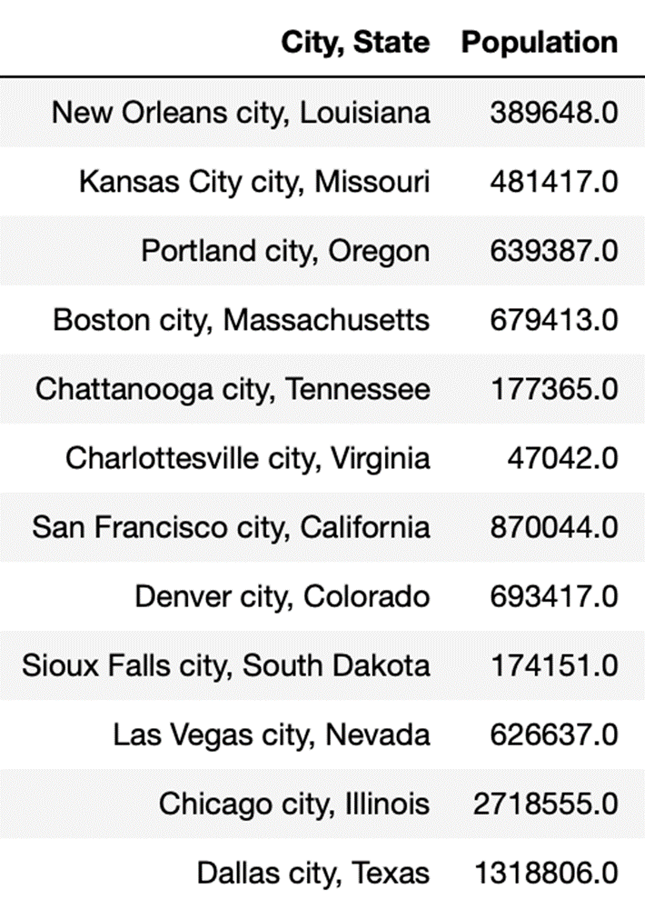
Data - Population
Notes:
To research the population, we created a jupyter notebook and used our census API key.
We did have some trouble with our API key because the census did not have the 2019 data we wanted, which of course we had to spend hours trying to figure out what was happening. So we then turned to the next best thing, using another year. We used 2018 for our population data.
And to find the population for each city also took some tinkering. To start we were only finding state populations, then county, then the wrong cities. But once we outsmarted jupyter notebook we created a dataframe for each of our 12 cities.
C.asc5.state_place
And looked up corresponding numbers for each city
In the end we merged all of the dataframes together to create one chart with all of the information we needed and exported into a csv to be used in our other data analyzation.

Slide 10
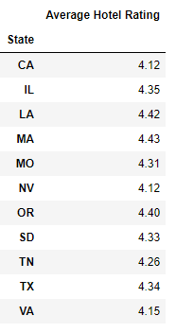
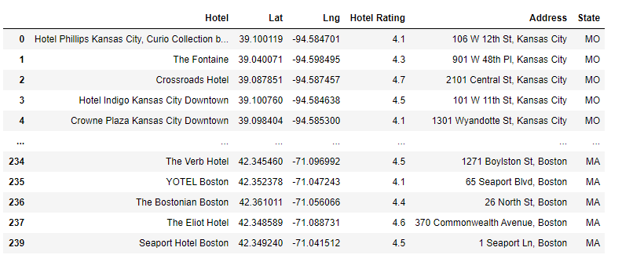
Data - Hotel
Notes:
To get hotel and hotel rating data I sent an API request to Google Places and used the nearby search to locate hotels within 8,000 meters of our 12 cities latitude and longitude. We spent quite a bit of time researching an API source for hotels with hotel ratings and ultimately decided Google Places provided what we needed. Once we had the data, I created a dataframe to display the results, added a column for state and used the insert method to add the state abbreviation. I then calculated the average hotel rating for each hotel, created a new dataframe and output it to a csv file.
I brought in that csv file and the crime csv file, which includes data for total crimes, total crime rates, total property crime rates, and total person crimes for each city to a new jupyter notebook and merged them on state. I created a map with info box for each city and the corresponding average hotel rating and a map with info box for each city, the city’s population, and the city’s total crime. I also created visualizations including bar charts and linear regressions so we could check for a correlation between crimes and ratings, and population and ratings.

Slide 11


Visualizations

Slide 12
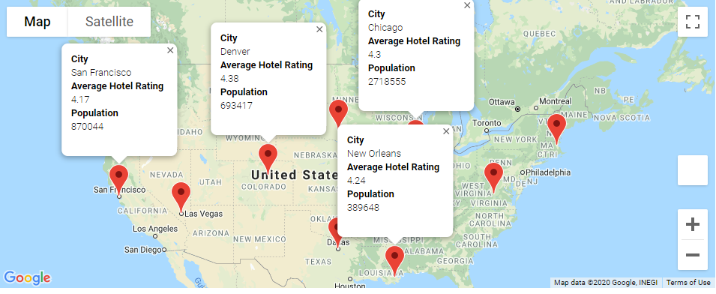
Average Hotel Rating per City and Population

Slide 13
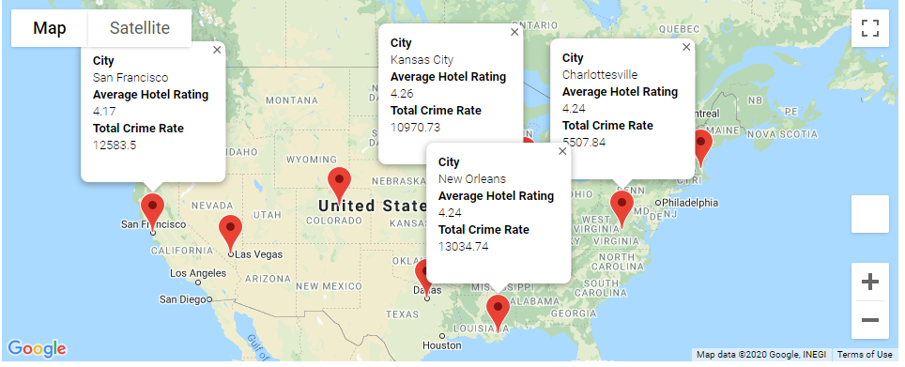
Population 2018, Crime Rates 2019, Hotel Rating

Slide 14
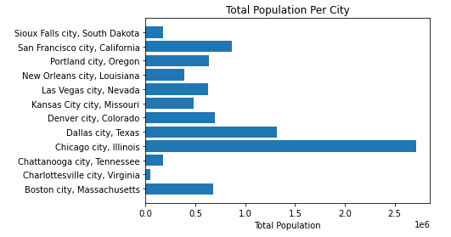
City Population 2018

Slide 15
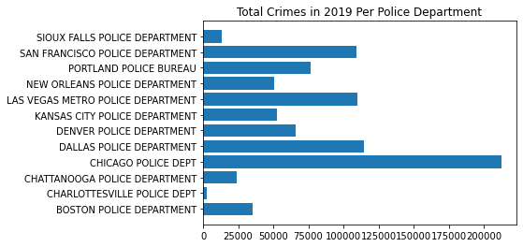
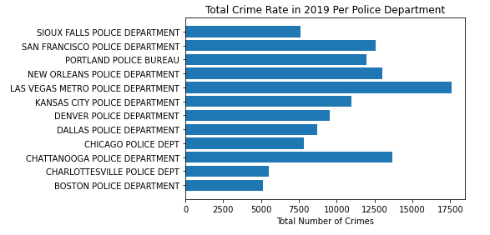
Total Crime Rate in 2019 Per Police Department
Total Crimes in 2019
Per Police Department

Slide 16
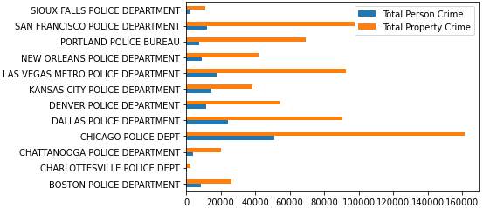
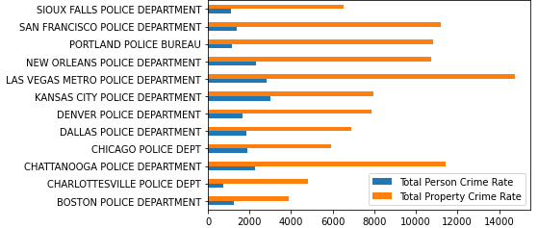
Type of Crime Occurrences vs Rates
Crime Occurrences
Crime Rates
Total person crime includes aggravated assault, homicide, robbery, sex crimes, and violent crime. Total property crime includes arson, auto theft, burglary, larceny, and property crime.

Slide 17


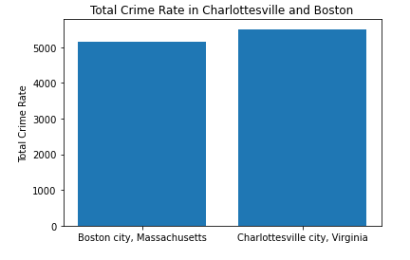
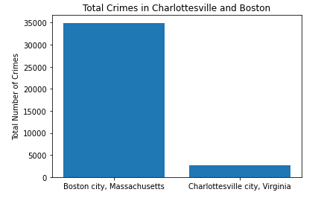
Boston, Massachusetts Population – 679,413 vs Charlottesville, Virginia Population – 47,042

Slide 18
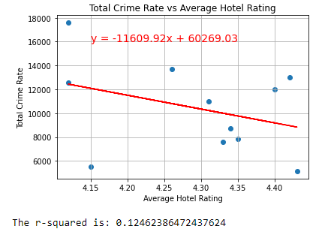
Total Crime Rate vs Average Hotel Rating

Slide 19
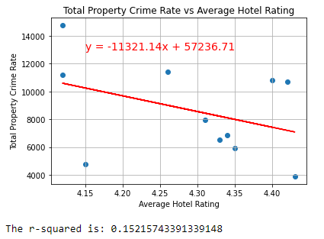
Total Property Crime Rate vs. Average Hotel Rating

Slide 20
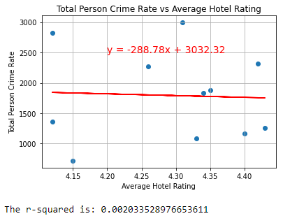
Total Person Crime Rate vs. Average Hotel Rating

Slide 21
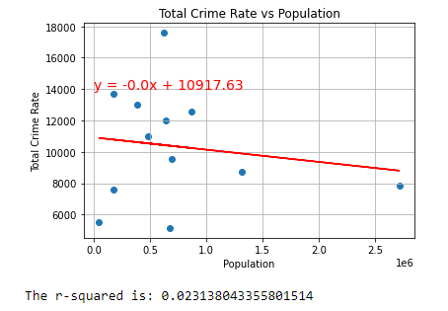
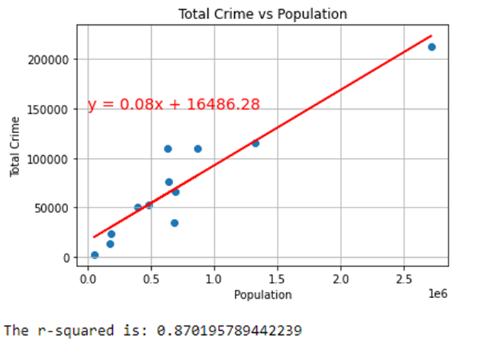
Total Crime Rate vs. Population
Total Crime vs. Population

Slide 22
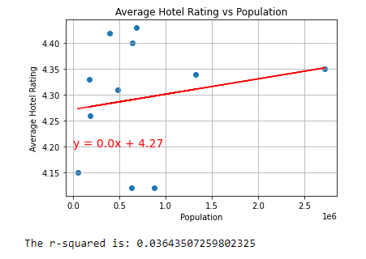
Average Hotel Rating vs. Population

Slide 23
Summary
Question 1: Is there any correlation between average hotel rating and crime rate?
There is a weak correlation between average hotel rating and crime rate when using overall crime rate (r value is 0.12). When breaking down the crime rate to person and property crime rates, there are some differences. With property crime rate, the r value is 0.15 another weak correlation. The person crime rate compared to average hotel rating has an r value of 0.002 making correlation non-existent. Average hotel rating could be affected by property crime rates.
​
Question 2: Is there any correlation between a city's population and crime rate?
The r value for total crime rate and city population is 0.02 which means correlation doesn't exist. However, when looking at the total crime occurrences and population, there is an r value of 0.87 which is a very strong correlation. This should not be surprising as more people means higher chance of crime.
​
Question 3: Is there any correlation between a city's population and average hotel rating?
The r value for city's population and average hotel rating is 0.03 making another non-existent correlation.
​
For our overall hypothesis, there is not strong correlation to suggest that crime rate has an effect on average hotel rating, nor is there a strong correlation between crime rate and population. Our findings are not enough to influence any future travel plans.
​

Slide 24
Future Research
Narrow our searches to neighborhoods instead of overall city data.
Include more hotels and categorize by hotel types (ex. star rating).
Investigate more cities.
What time of year has the highest crime rate?

